Slide 1

Dynamic & Proactive Organic Farming : OrganiCrate
Group No. 9
Group members Student Id
Pranit Kadlag 16204005
Kunal Band 16204004
Subodh Khobrekar 16204007
Rahul Vishwakarma 16204018
Project Guide and Co-guide
Prof. Sunil Sushir
Prof. Anagha Aher

Slide 2
Contents
Abstract
Introduction
Literature Review
Problem Statement
Project Scope
Use Case Diagram
Architecture
Project Planning
Summary
References

Slide 3
Abstract
Foods are available in market which is made by using many artificial fertilizers. These chemicals are very harmful for the human beings health especially for the children. In our propose system products get available which are grown without chemical fertilizer and made available for customers in a good price. In proposed system provide direct interaction between farmer and the customer. We are implementing forum for farmers, where each and every queries asked by the farmers are discussed and appropriate solution are given. Artificial Intelligence and Machine Learning Technologies in our system for product recommendation for our customers based on their product sales. To handle traffic running on our server will be balanced using tool Nginx.

Slide 4
Introduction
The term “organic” refers to the way agricultural products are grown and processed. Organic produce and other organic ingredients in retail products are grown without the use of synthetic pesticides and fertilizers, sewage sludge, genetically modified organisms or ionizing radiation[4].
Proposed System provide online product which are growth in natural way. By log in customer can choose product, add to cart and purchase. Farmers and vendor can add their product by their log in.
We are using a novel collaborative filtering based personalized recommendation method for E-commerce platform. That contain 3 modules 1) Behavior record module, 2) Model analysis module, and 3) Recommendation algorithm module[4].

Slide 5
Literature Review
Sr no. | Author name | Paper name | Merits | Demerits
1 | Ruchika, Ajay Vikram Singh, Mayank Sharma Amity Institute of Information Technology, Amity University, Uttar Pradesh, Noida | Building an Effective Recommender System Using Machine Learning Based Framework, 2017 | In this paper, describes recommendation based on implicit and explicit feedback using adaption of collaborative filtering in Apache Mahout platforms via Eclipse on a sample data set. | In this paper the problem of scalability was solved by the mahout to a certain extent because of the presence of hadoop framework. But with the increasing size of data sets it does not fit all.
2 | S.Wilson Prakash, Dr.P. Deepalakshmi,Department of Computer Science and Engineering | Server-based Dynamic Load Balancing, 2017 | In this paper,proposed a dynamic server load balancing algorithm based on OpenFlow and sFlow to distribute the load efficiently among the cluster of servers. | In this paper switchesreactively based on the load of the servers measured based on the memory usage, CPU usage, & active connection counts.

Slide 6
Literature Review
Sr no. | Author name | Paper name | Merits | Demerits
3 | Mr. Sunil A. Sushir, Ms.Rujata Chaudhari, Asst.Prof., Department of Information Technology. | Survey of Electronic Payment Systems, 2018 | The different categories of electronic payment systems in terms of online payment processes, authentication mechanisms, and authentication types. | Paper will be further demonstrate application of the different authentication mechanisms and types in the categories of the electronic payments system highlighted.
4 | Liu Yan Department of Business Administration, Shenyang Polytechnic College, Liaoning Shenyang 110045, China | Personalized Recommendation Method for E-Commerce Platform based on Data Mining Technology, 2017 | In this paper proposed personalized recommendation algorithm. This algorithm contain on three modules 1) Behavior record module, 2) Model analysis module, and 3) Recommendation algorithm module. | This paper describes recommendation based on personal behavior only, recommendation based on personal information will be further demonstrate

Slide 7
Problem Statement
Most of people get sick by what they eat .Food available in market is made by pesticides and fertilizers, sewage sludge etc. To make aware people about organic food and make available food online easily. Organic food which is growth in natural environment and made available from direct farmer’s or vendor.

Slide 8
Project Scope
Organic food made available online so anyone can buy.
User friendly Design.
Recommendation Email notification when new offer/product available .
Product Recommendation.
Load balancing using Nginx.
Provide secure payment portal.
Provide privacy to the all user(customer/vendor/farmer).

Slide 9
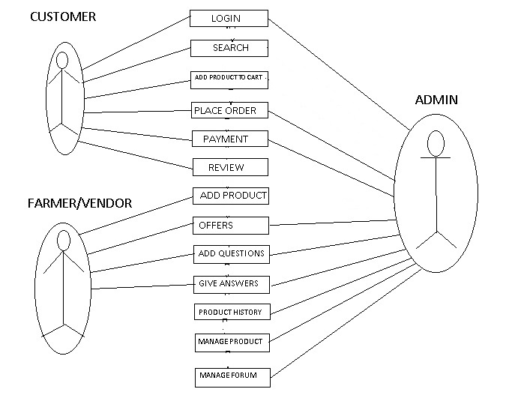
Use Case Diagram

Slide 10
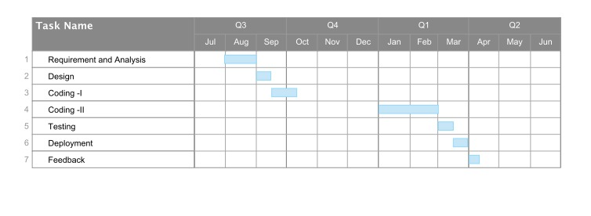
Project Planning

Slide 11
Summary
The proposed model provides food which is made without use of any artificial pesticides and fertilizers. It is available online 24x7 so anyone can buy it easily. our proposed model give direct interaction of customer to farmer. It provides great profit to farmers. We will be looking for recommendation of product based on customer sales and their interest. We also look forward to discover notification feature which is notified to customer when any new product or offer is launched. Also discover forum for farmers.

Slide 12
References
[1] Ruchika, Ajay Vikram Singh, Mayank Sharma, ”Building an Effective Recommender System Using Machine Learning Based Framework”, Amity Institute of Information Technology, Amity University, Uttar Pradesh, Noida
[2] S.Wilson Prakash, Dr.P. Deepalakshmi, ”Server based Dynamic load balancing”, Department of Computer Science and Engineering,Kalasalingam University, 20-22 july,2017.
[3] Mr. Sunil A. Sushir, Ms. Rujata Chaudhari, ”Survey of Electronic Payment Systems”, Asst. Prof., Department of Information Technology,A. P. Shah Institute of Technology,April 20-21, 2018.
[4] Liu Yan ” Personalized Recommendation Method for E-Commerce Platform based on Data Mining Technology ” Department of Business Administration, Shenyang Polytechnic College, Liaoning Shenyang 110045, China
[5] http://www.zbnfonline.org

Slide 13


Slide 14
Thank You…!

